Slide 1
SegNet: A Deep Convolutional Encoder-Decoder Architecture for Image Segmentation Authors : Vijay Badrinarayanan, Alex Kendall, Roberto Cipolla
Presented by:
Md Mossadek Touhid (1707068)
Submitted to:
Dr. K. M. Azharul Hasan
Professor &
Md. Motaleb Hossen Manik
Lecturer
Department of Computer Science and Engineering
Khulna University of Engineering & Technology

Slide 2
Outline
Objectives
Introduction
Model Architecture
Methodology
Dataset Description
Benchmarking
Result Analysis
Discussion and Future Work
Conclusion

Slide 3
Objectives
To develop a architecture that is for semantic pixel-wise segmentation termed SegNet.
To know about the encoder and decoder model of this architecture.
To test the proposed architecture with road scenes and SUN RGB-D indoor scenes dataset.
To compare this proposed architecture with widely adopted FCN, DeepLab-LargeFOV, DeconvNet architectures.

Slide 4
Introduction
Semantic Segmentation is classifying each pixel of the image to its class label.
It has two parts.
The encoder is usually is a pre-trained classification network like VGG followed by a decoder network.
The task of the decoder is to semantically project the discriminative features (lower resolution) learnt by the encoder onto the pixel space (higher resolution) to get a dense classification.

Slide 5
Model Architecture
SegNet, is designed to be an efficient architecture for pixel-wise semantic Segmentation.
An encoder network and a corresponding decoder network.
The encoder network consists of 13 convolutional layers like first 13 convolutional layers of VGG16 network.
Hence the decoder network has 13 layers.
The final decoder output is fed to a multi-class soft-max classifier.
Produces class probabilities for each pixel independently.

Slide 6
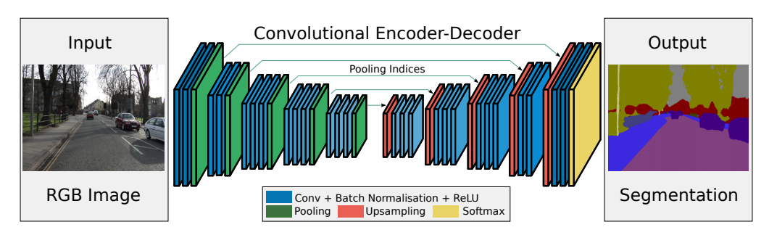
Fig. 1: SegNet Architecture

Slide 7
Methodology
Encoder Network:
Performs convolution with a filter bank to produce a set of feature maps.
These are then batch normalized.
Then an element-wise rectified linear non-linearity (ReLU) is applied.
Following that, max-pooling with a 2x2 window and stride 2 (non-overlapping window) is performed
Then sub-sampling is applied .

Slide 8
Methodology (Cont.)
Decoder Network:
Up-samples its input feature map using memorized max-pooling indices to produce sparse feature maps.
These are then batch normalized.
Then the high dimensional feature is fed to soft-max classifier at output of final decoder.
This SegNet decoding technique is illustrated in Fig. 2 below.

Slide 9
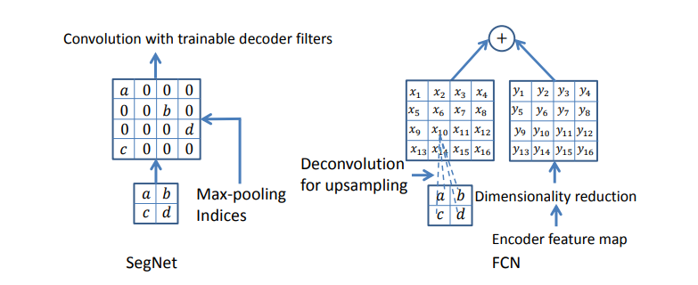
Fig. 2: An illustration of SegNet and FCN decoder

Slide 10
Dataset Description
CamVid road scenes dataset:
Small, consists of 367 training and 233 testing RGB images. 11 classes such as road, building, cars, pedestrains, signs, poles, side-walk etc.
SUN RGB-D Indoor Scenes:
Indoor scenes with 5285 training and 5050 testing images. 37 indoor scene classes including wall, floor, ceiling, table, chair, sofa etc.

Slide 11
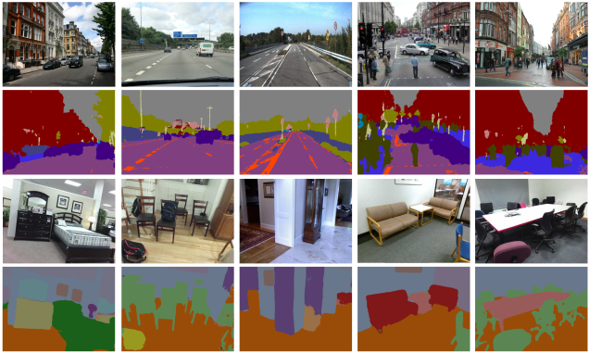
Fig. 3: SegNet predictions on road scenes and indoor scenes

Slide 12
Benchmarking
Performance of SegNet on two scene segmentation.
Benchmark Segnet against several other well adopted deep architectures for segmentation such as FCN, DeepLab-LargFOV and DeconvNet.
Understanding the performance of these architectures when trained on same dataset.

Slide 13
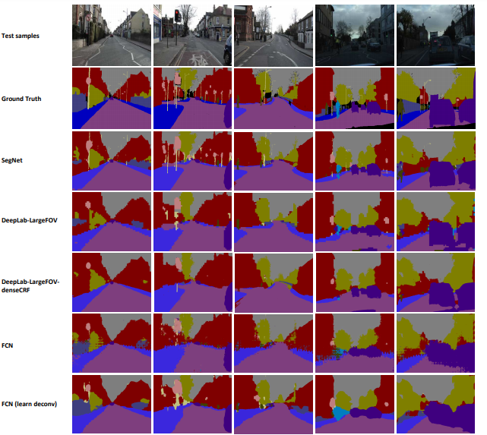
Fig. 4: Results on CamVid test samples

Slide 14
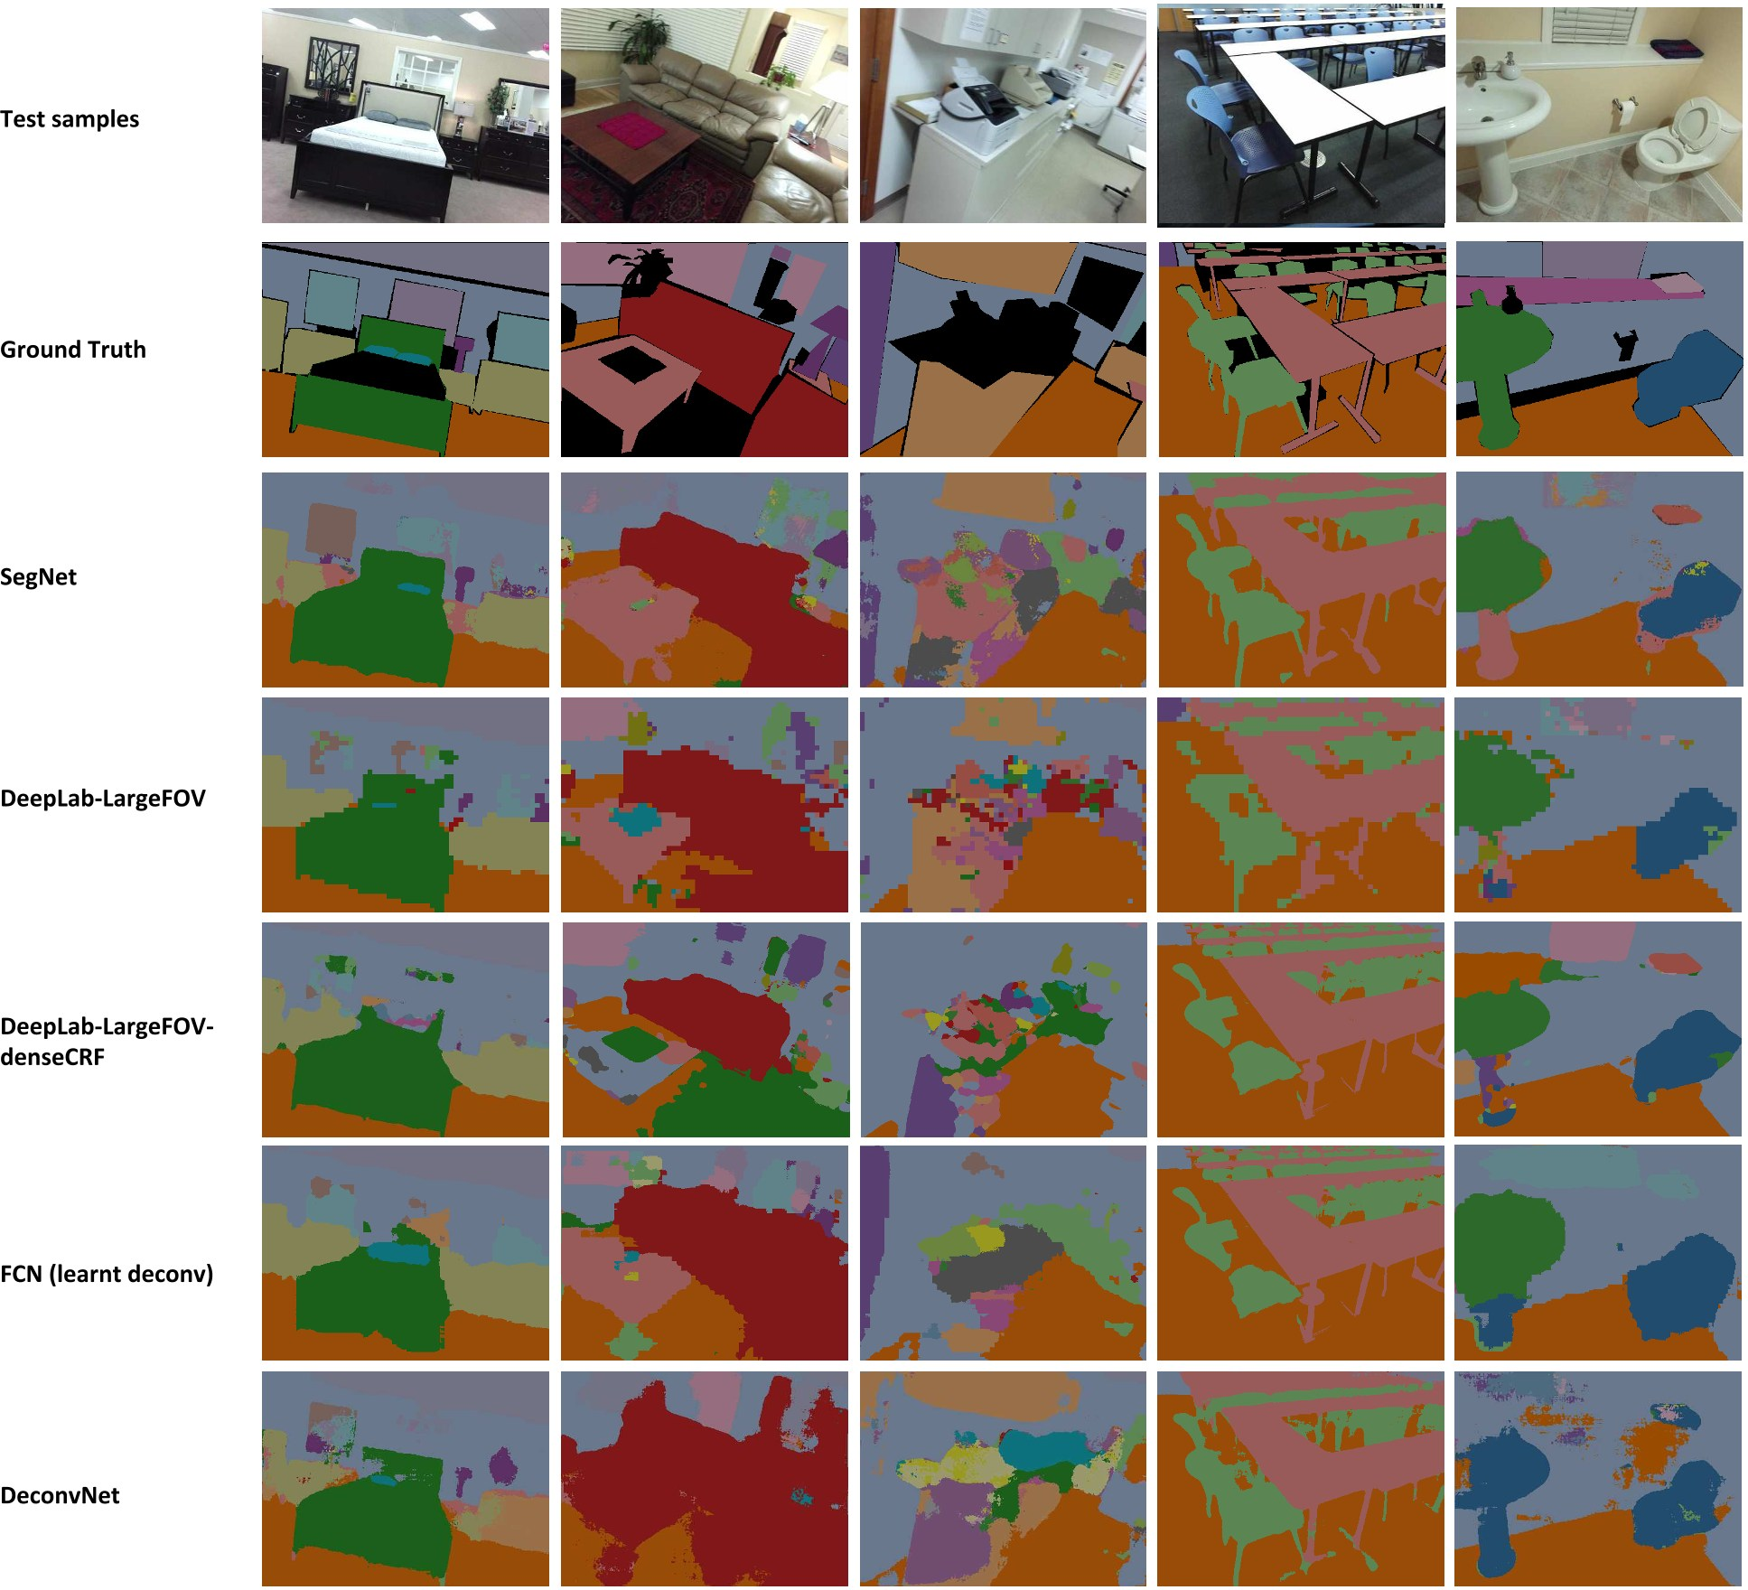
Fig. 5: Results on RGB indoor test scenes

Slide 15
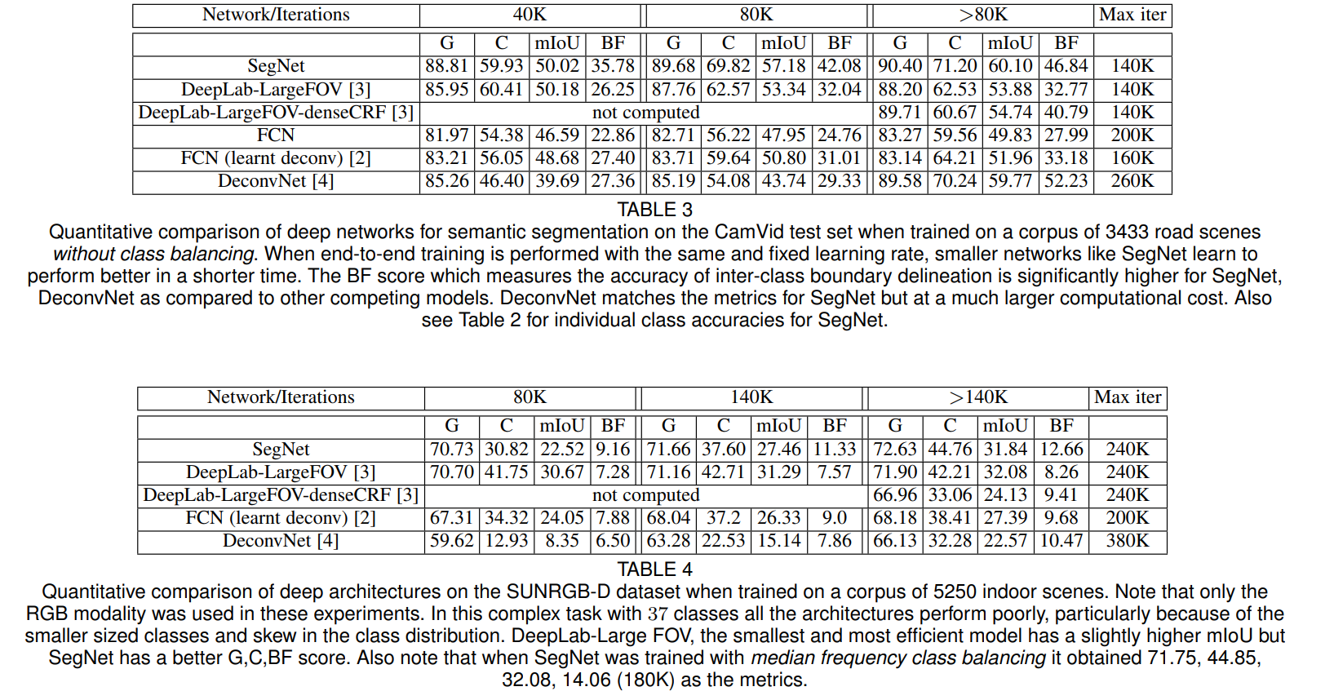

Slide 16
Result Analysis
SegNet outperforms all other methods in terms of G, C, BF metrics and has a slightly lower mIOU than DeepLab-LargeFOV.
With same and fixed learning rate, SegNet performs better.
SegNet has less computational cost.

Slide 17
Discussion and Future Work
Discussion :
Scene segmentation is more challenging due to high variability of scenes.
Outdoor and Indoor segmentation is more practically oriented with current applications such as autonomous driving, robotics etc.
Future Work :
This will help to design more efficient architecture for real-time applications.

Slide 18
Conclusion
SegNet is efficient both in terms of memory and computational time.
Particularly training time, memory vs accuracy.
Other architectures store full encoder network feature map for best performance but consume more memory during inference time.
But, SegNet only stores the max-pooling indices of feature maps.
That’s why it’s achieving high scores.

Slide 19
References
[1] K. Simonyan and A. Zisserman, “Very deep convolutional networks for large-scale image recognition,” arXiv preprint arXiv:1409.1556, 2014.
[2] J. Long, E. Shelhamer, and T. Darrell, “Fully convolutional networks for semantic segmentation,” in CVPR, pp. 3431–3440, 2015.
[3] C. Liang-Chieh, G. Papandreou, I. Kokkinos, K. Murphy, and A. Yuille, “Semantic image segmentation with deep convolutional nets and fully connected crfs,” in ICLR, 2015.
[4] H. Noh, S. Hong, and B. Han, “Learning deconvolution network for semantic segmentation,” in ICCV, pp. 1520–1528, 2015.
[5] X. Ren, L. Bo, and D. Fox, “Rgb-(d) scene labeling: Features and algorithms,” in CVPR, pp. 2759–2766, IEEE, 2012.

Slide 20
Thank You Any Questions?

